Slide 1

Very-Near-Field Solutions to Far-Field EMC Problems
Advanced Embedded Systems
September 09, 2015
EMxpert
Pre-Compliance EMC Testing

Slide 2


EMSCAN Corporation
Very-near-field magnetic measurements expert
  Unique patented products for RF/MW and EMC/EMI
Private Canadian corporation since 1989
  Worldwide coverage
Recognized innovative products

Slide 3
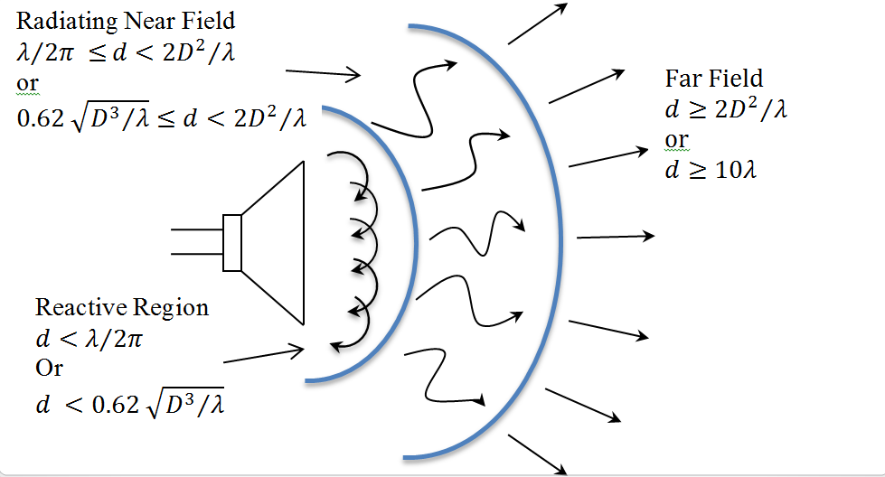
What is Very-Near-Field?
Far-field is where the
pattern is not changing
with the distance
Near-field is anything not in
the far-field
Stay out of the reactive
region
  Very-near-field

Slide 4
Introduction
World Leading Developer of Visual Real-Time
EM and RF Pre-Compliance Test Solutions
Antenna and PCB Designers
Product Integration and Verification Engineers
Diagnostic Tool
Manufacturing Quality Control

Slide 5
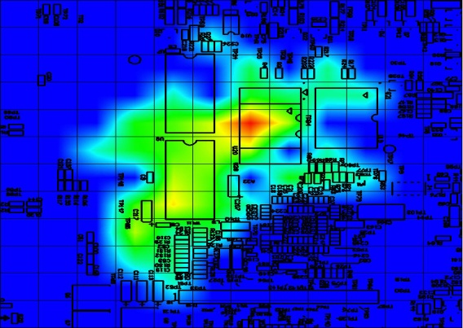
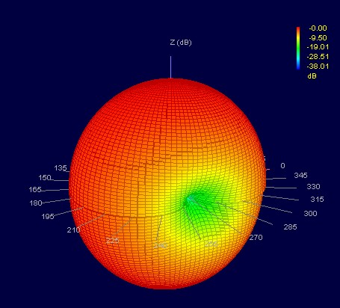
Chambers on your Desktop
EMxpert
  EMC diagnostic tool to rapidly diagnose and solve EMC/EMI problems with real-time PCB emission analysis
RFxpert
  APM tool enabling to quickly evaluate performance and optimize designs with real-time antenna performance characterization
Notes:
5

Slide 6
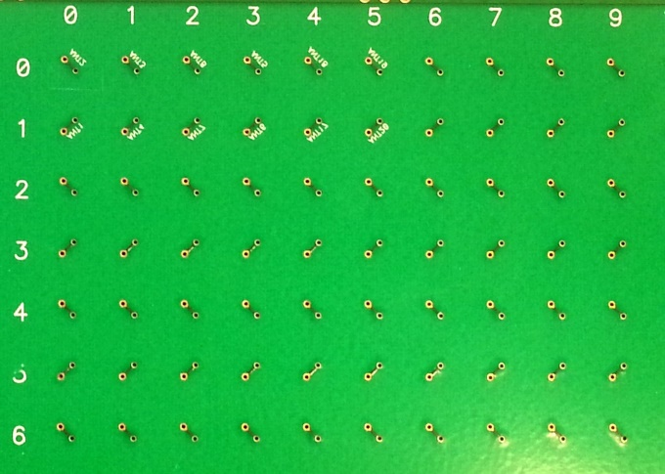
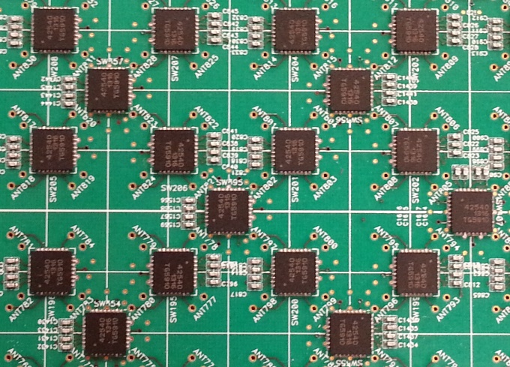
Fundamentals
High-density planar antenna array
High-speed electronic switching
Very-near-field measurements
Far-field predictions
“Real-time” real-fast
No chamber

Slide 7

Overview

Slide 8
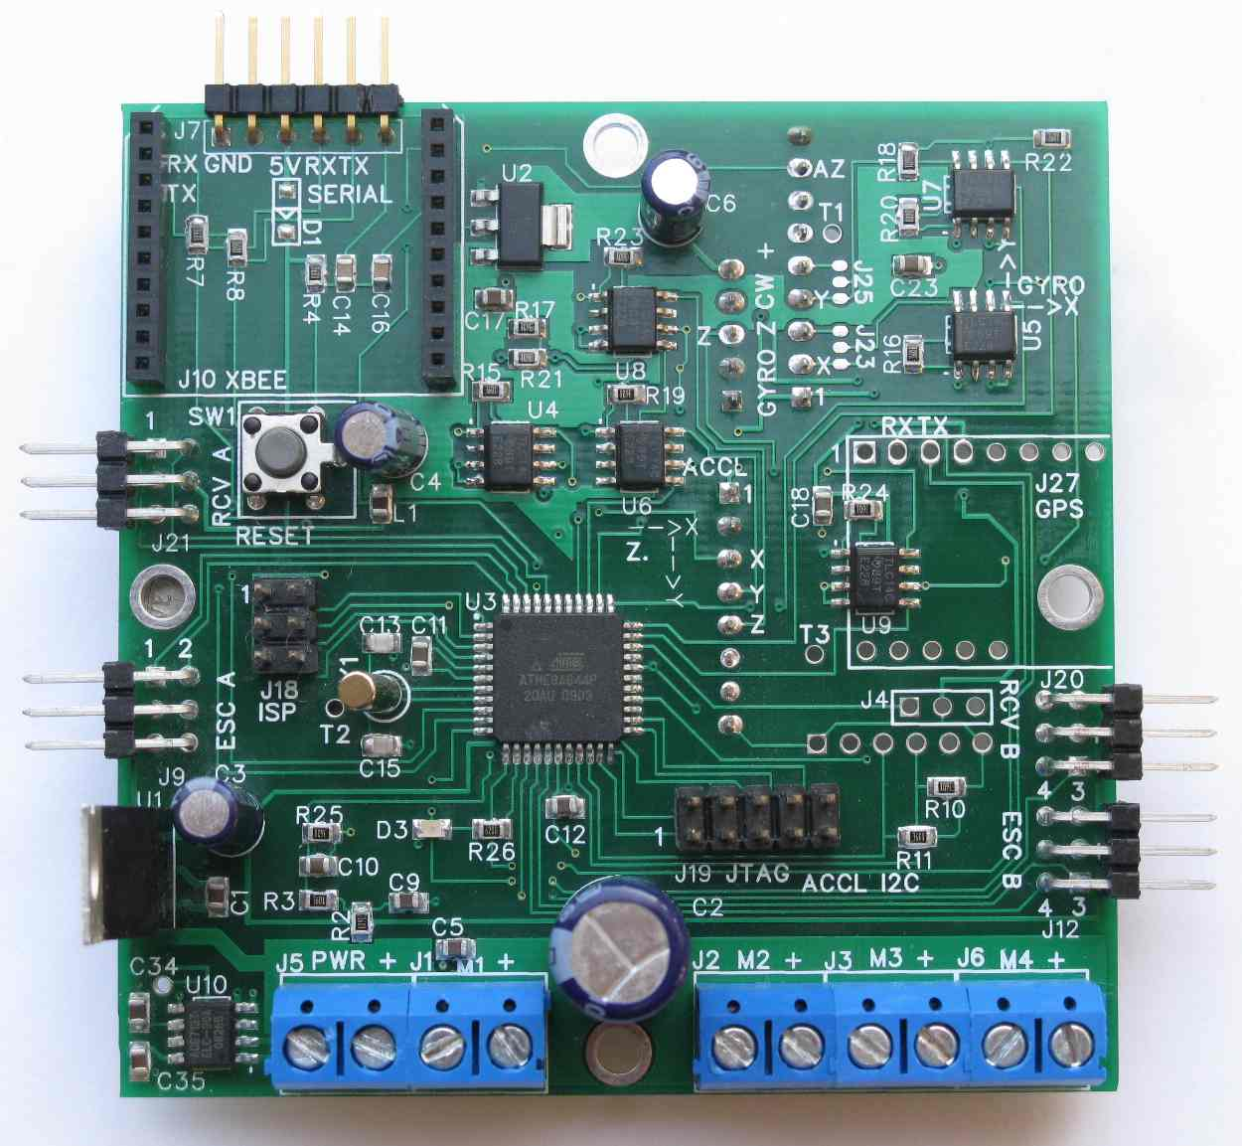
PCB Radiated EMC/EMI/EMS Issues
EMC prevention an afterthought
Little interest in EMC
EMC as a black art

Slide 9
Every EMI (electromagnetic interference) problem ultimately starts or ends at an electronic circuit
Daryl Gerke and Bill Kimmel
IN COMPLIANCE MAGAZINE JULY 2013

Slide 10
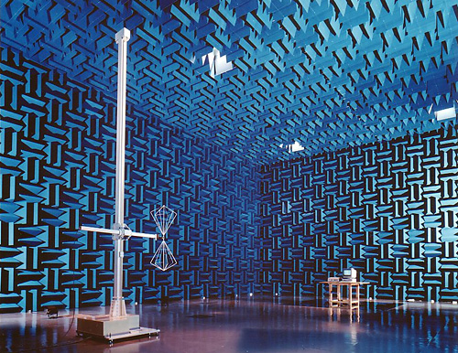
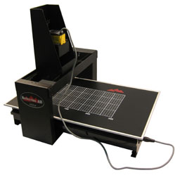
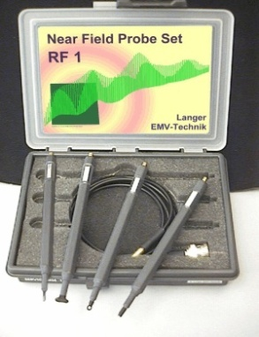
Existing Solutions
Chambers
  Slow testing
    Compliance
  High CAPEX (in-house)
    Real-estate
    Qualified technicians
  High OPEX (third party)
Probes
  Slow testing
  Resolution nm
Simulation software
  Time consuming to customize per PCB
  Extensive training required

Slide 11
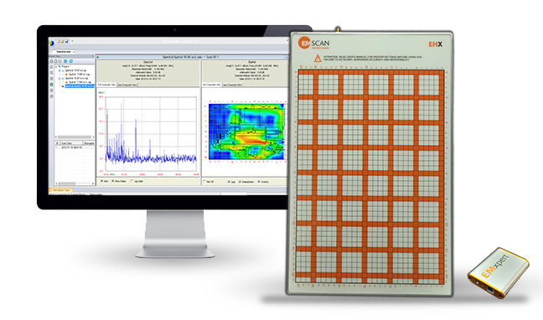
The Better Solution: EMxpert
Directly addresses the challenges
Fast measurements
  Continuous “real-time”
  Single spatial scan in seconds
Compact tabletop instrument
Cost effective solution

Slide 12
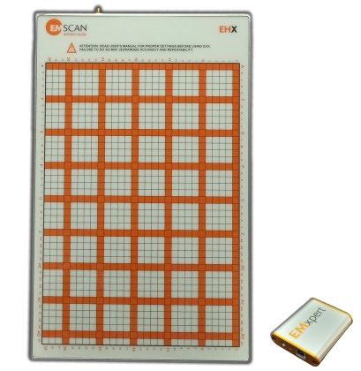
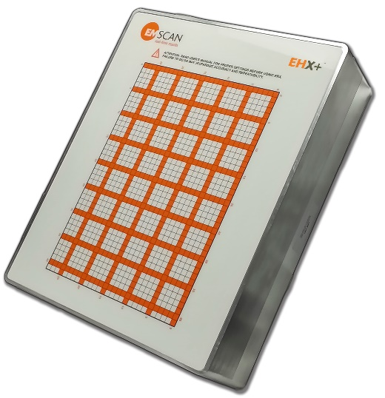
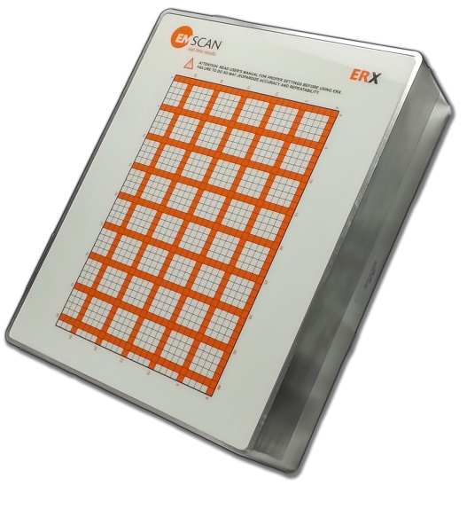
EMxpert Family
EHX
EHX+ ERX+

Slide 13
Technical Specifications

Slide 14
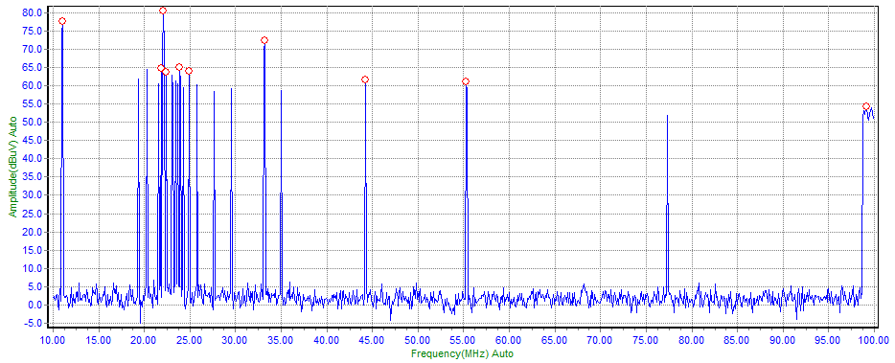
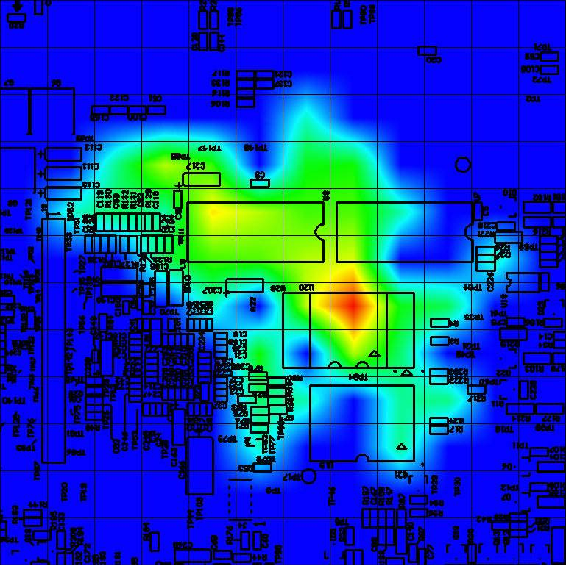
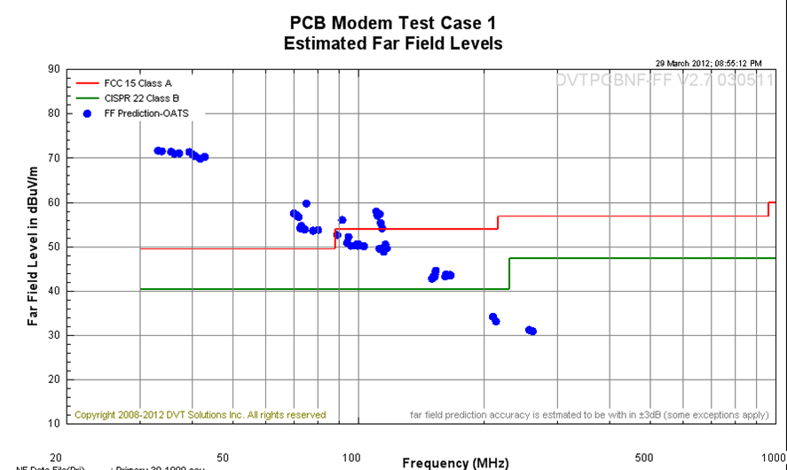
Functionality
Spectral scan
  Problem frequencies
Real-time near-field spatial scan
  Sources of radiated emissions
Far-Field prediction
  Pre-compliance regulatory data
Frequency: 150 kHz to 8 GHz
Resolution: 3.75 mm to 0.1 mm
Compare and overlay functions
Automated report generator

Slide 15
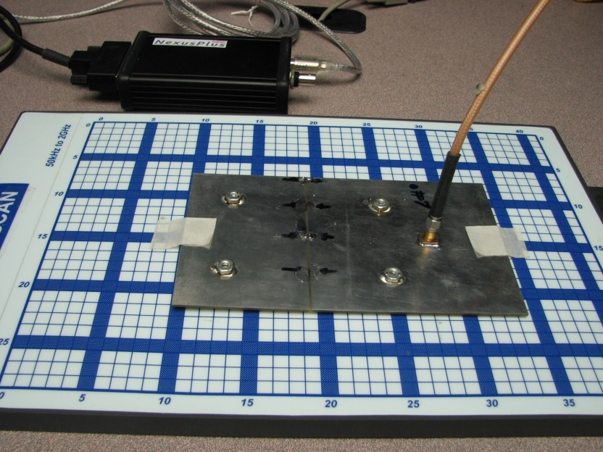
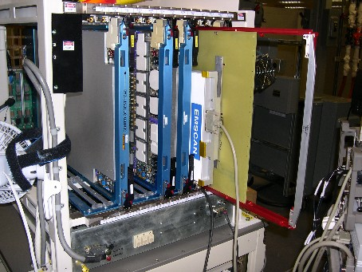
Modes of Operation

Slide 16
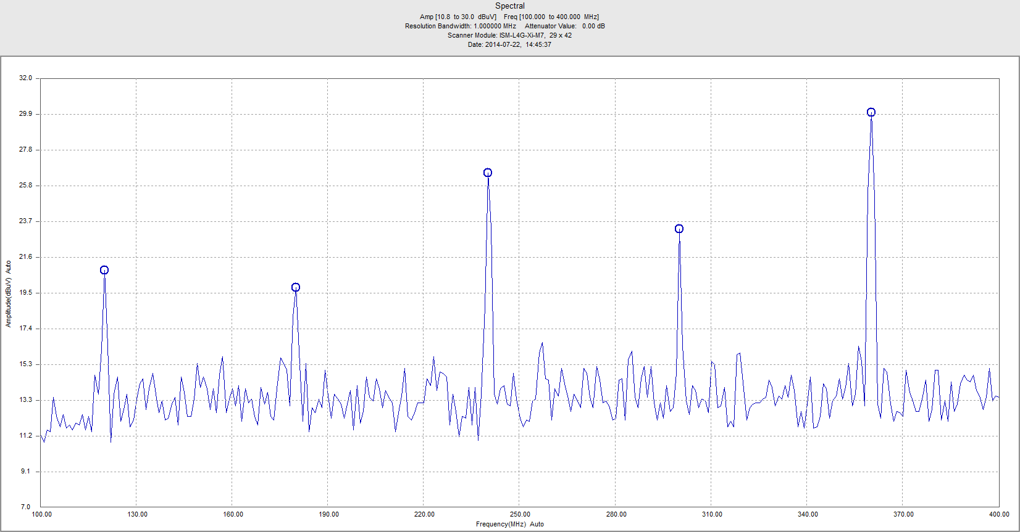
Spectral Scan: Scanner

Slide 17
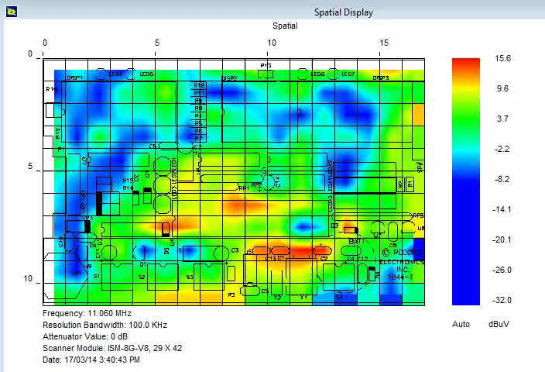
L1 Spatial Scan: Real-Time Scanner

Slide 18
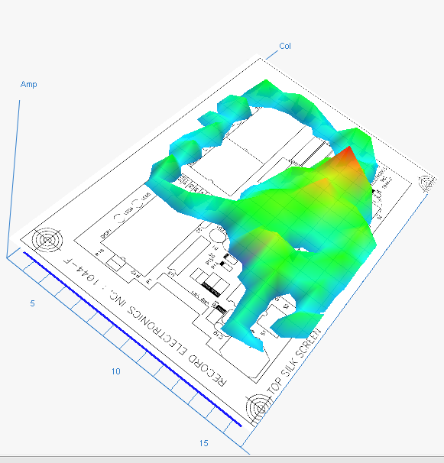
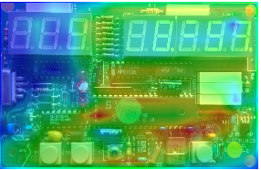
L1 Scan: Single-Frequency

Slide 19
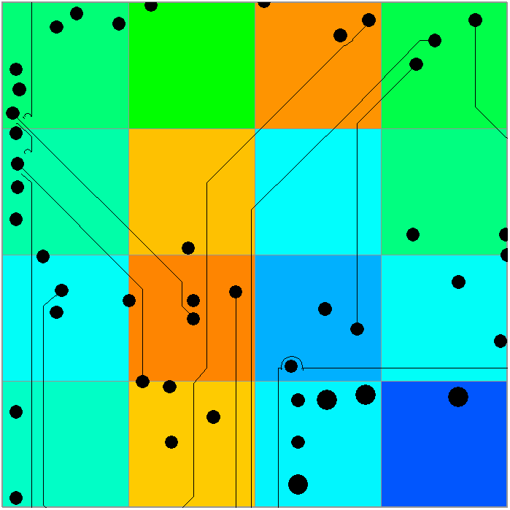
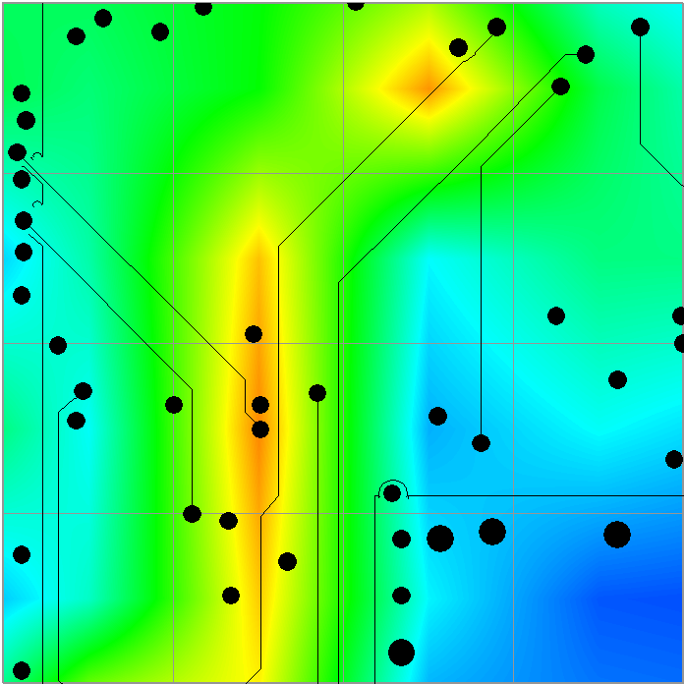
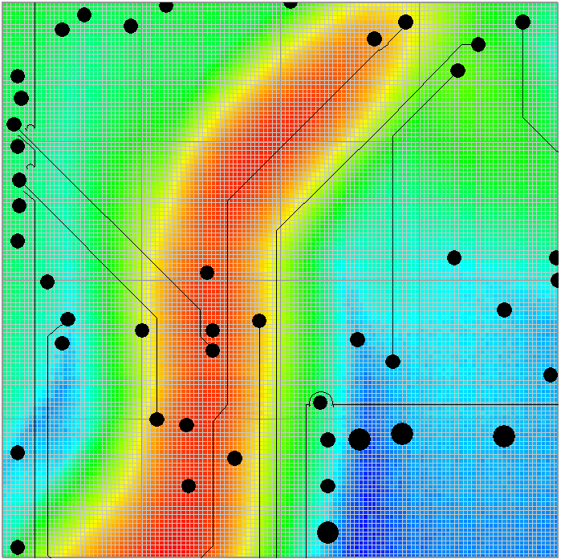
L2-L7 Spatial Scan: Post Capture High Res.

Slide 20
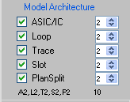
Far-Field Application
Predict radiated EMI of PCB 30 MHz – 6 GHz
  Compensated EMxpert very-near-field data
  PCB structure and design models
Absorber mat

Slide 21
Applications

Slide 22
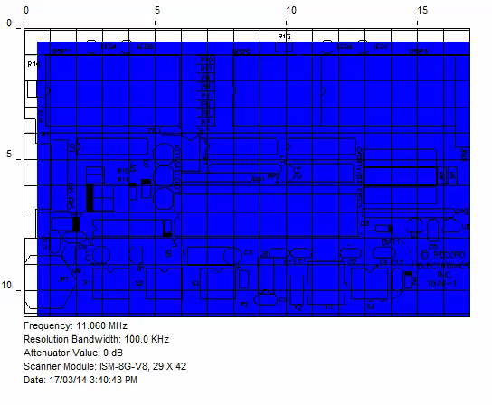
Real-Time
Intermittent peaks
  Source
  Path
  Distribution
Functional mode
  Highest emission

Slide 23
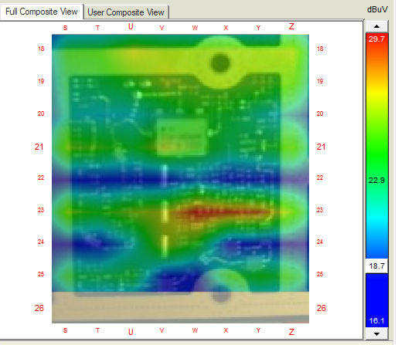
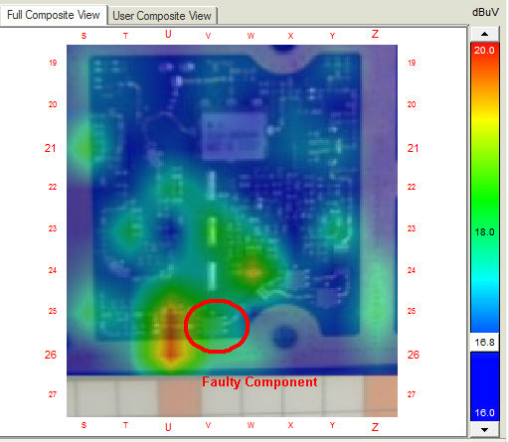
A/B Comparison
Obsolescence management
Production unit versus gold standard
Fault diagnosis

Slide 24
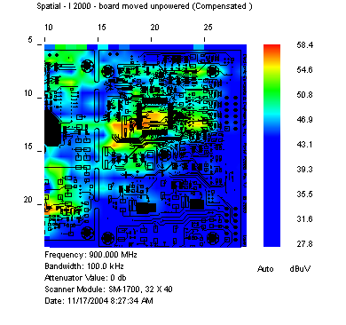
Immunity Insights
Injected signal path
Component susceptibility
Effects on functionality

Slide 25
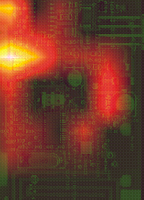
Common Mode
How signals couple onto connectors creating common mode problems

Slide 26
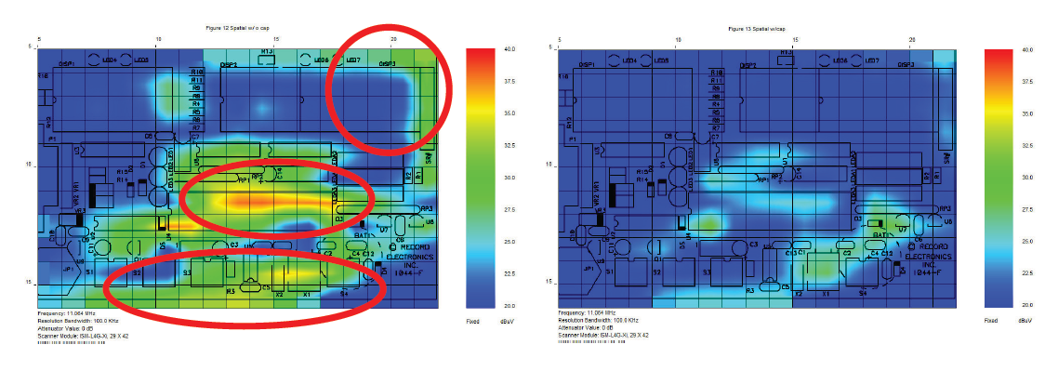
Effectiveness of Filters

Slide 27
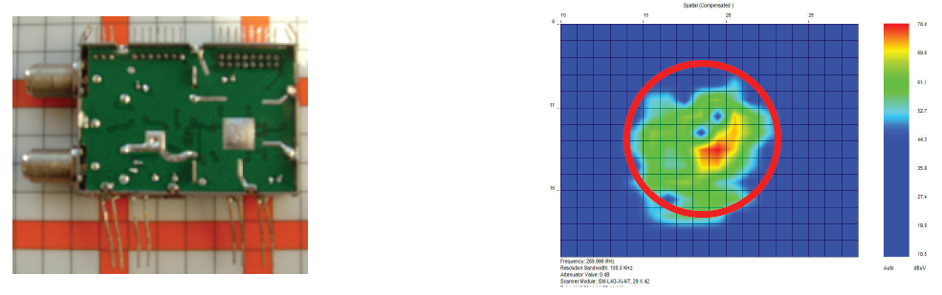
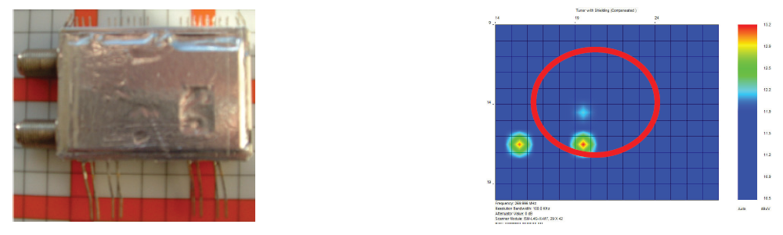
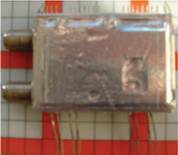
Effectiveness of Shielding

Slide 28
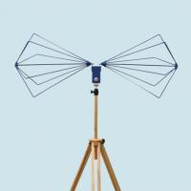
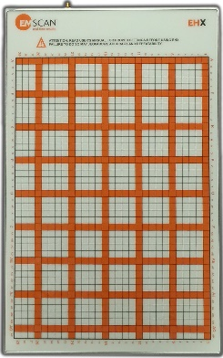
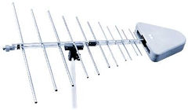
Pre-Compliance
Far-field measurements in a “virtual chamber”
Far-field prediction FCC, ANSI, CISPR and user-defined limit lines

Slide 29
Conclusion

Slide 30
Advantages
“Real-time” view of emission sources and distribution
Continuous peak hold scan for spurious events
World’s fastest high-resolution testing
World’s fastest pre-compliance data
Low acquisition cost

Slide 31
Benefits
Improved TTM and R&D productivity
  Test time reduction > 100 x
  Rapid design iteration, prototyping & optimization
Reduced chamber costs
  Delayed investment in new chambers
  Third party test expenses
Cost effective preparation to compliance

Slide 32

Some Customers

