Slide 1
Geo Sensors - Human Sensors
Or Just Sensors
Rick Hu, MD,FRCSC
CEO/Founder
Vivametrica
Rick@vivametrica.com

Slide 2
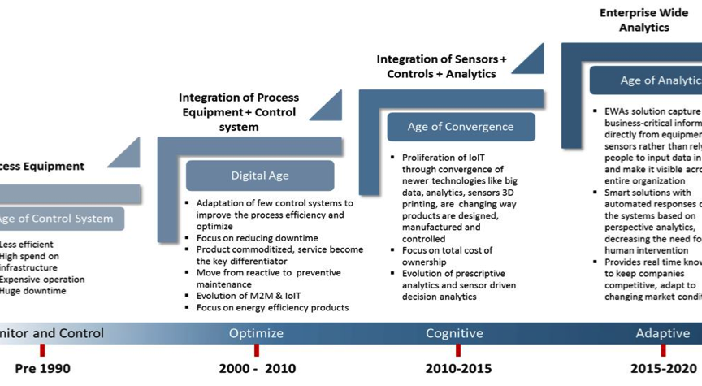
Adoption of Technology and Analytics Over Time

Slide 3
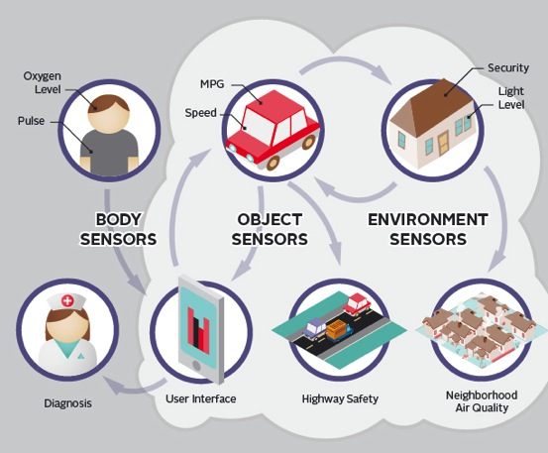
Sensors are becoming Ubiquitous

Slide 4
Big Data/Sensors
Seismic Data
Inventory control and management
Production forecasting
Transport, Refining, distribution

Slide 5
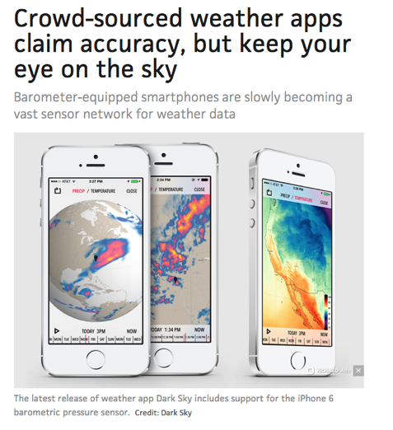
Meteorological Information

Slide 6
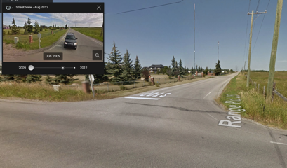
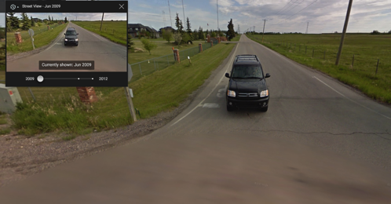
Google Maps
Often used in combination with mobile GPS Sensors
Much of the available satellite imagery is no more than three years old and is updated on a regular basis

Slide 7
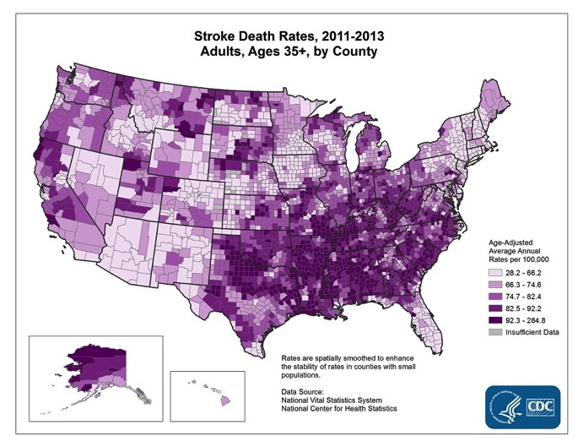
Geographical Information and Health

Slide 8
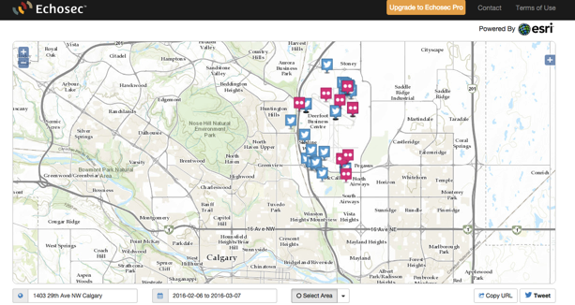
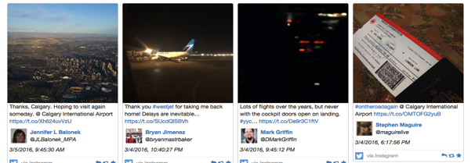
Analysis of Geo-social Information
Echosec is a location-based search platform that provides actionable knowledge based on social media and other information.

Slide 9

Applications in Healthcare
  Position Health
    Use smartphone geopositioning technology to recognize when a patient is entering an acute care facility anywhere in the US connecting provider teams

Slide 10
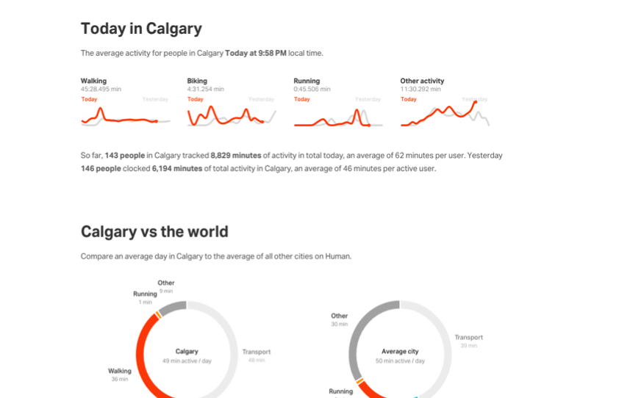
Analysis of Activity Based on Geographical Location

Slide 11
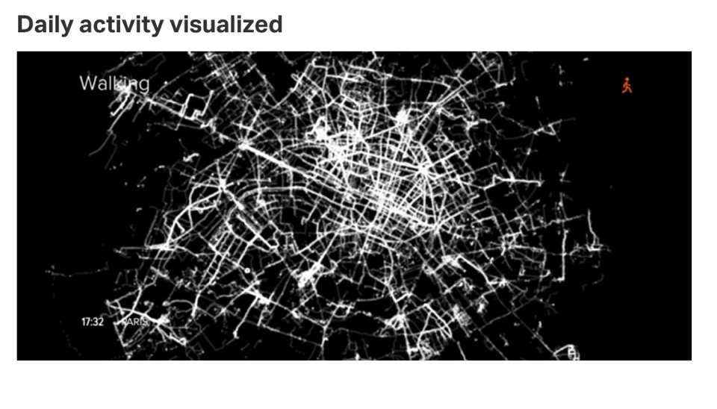
Data Visualization

Slide 12
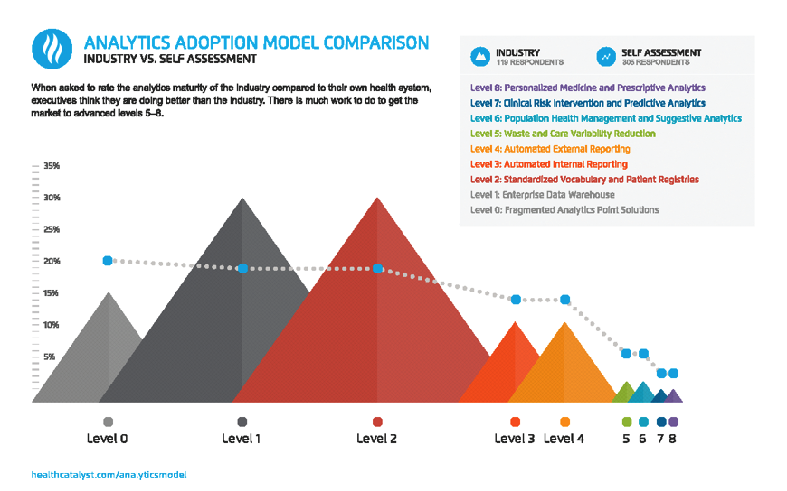
Comparison of Analytics Adoption

Slide 13

Life happens : Analyze it
Rick Hu, MD CEO/Founder
rick@vivametrica.com
Christy Lane, PhD COO/Co-Founder
Christy@vivametrica.com

Slide 14
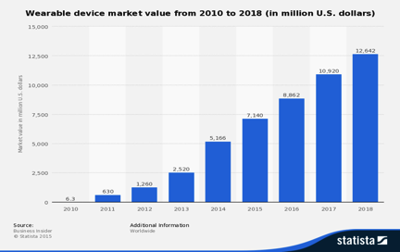
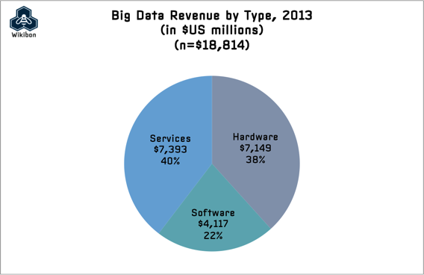
Wearable Tech Landscape
2016 – $8 B
2017 - $11 B
2013 - $18.8B
2016-02
Notes:
The wearable device market is on the rise.
It’s reported that by next year will be moving from a 8B market to a 11B market.

Slide 15
Absenteeism and Disability
Stress Related Absenteeism
$3600 per US Worker/year ^{(Circadian Report)}
$84 B annual US lost productivity ^{(Gallup} ^{Healthways Survey)}
There was a 27% increase in long-term disability costs over just a two year period, with an emphasis on mental health claims and inability to cope with increased productivity demands²

Slide 16

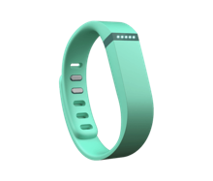
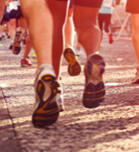
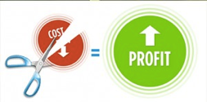

Wearables for Corporate Wellness
2016-02
Notes:
Companies have started looking at wearable technology as a way to track and enhance corporate wellness. Hoping to reduce the cost of sick days,

Slide 17

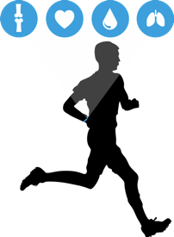
Problems -User Engagement/Meaningful Information
Six months
< 50%
Still using
device
What does the information mean?
2016-02

Slide 18
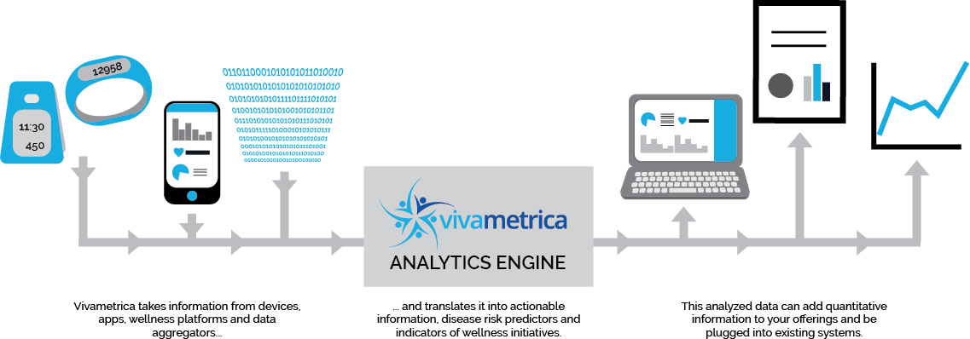
Vivametrica Solution
DATA INPUT
Wearables and other data
Geo-location
Meteorological
Health Data
USER ENGAGEMENT
Personalized
Goal setting
Individual and aggregate
MEANINGFUL ANALYSIS
Proprietary Algorithms
Population Comparisons
Individual Risks estimates
Financial Calculators
2016-02

Slide 19
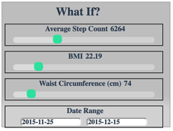
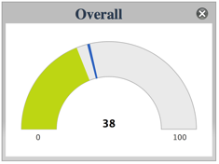
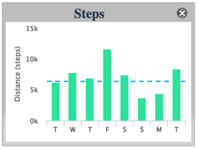
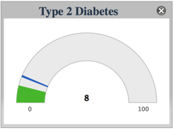
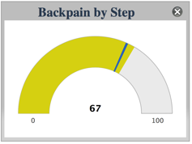
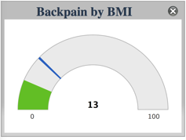
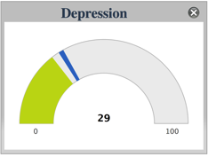
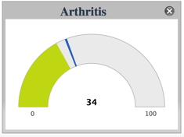

Display Tools

Slide 20
Sample Analysis Enterprise Client – Program Effectiveness Data from 3500 Employees

Slide 21
The Technology
Standardization
  Collect data from different devices.
  Standardization algorithm to ensure data is comparable.
Benchmarking: “People Like Me”
  Individuals and groups compare to other individuals and groups in the general population or workplace.
  Comparisons based on metrics including:
    risk for disease, physical activity, sleep, BMI, age, gender, and job category.
  Goal Setting and Behavior Change tools
  Interactive tools to set goals and improve health behaviours
2016-02

Slide 22
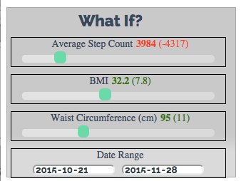
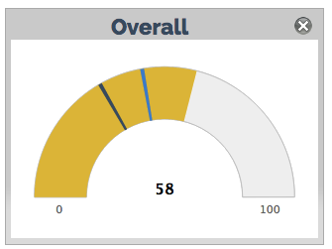
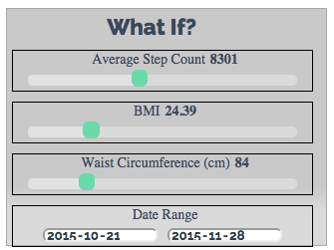
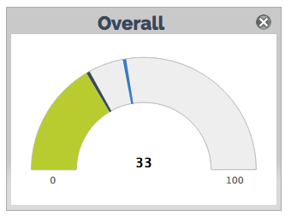
Goal Setting and Behavior Change:
"What if?" Tool
Original State – 4000 Steps
Above average overall risk of Cardiac/Lung/Type II DM/Arthritis
Goal setting – New state – 8300 Steps
Below average overall risk.

Slide 23
Goal Setting and Behavior Change:
"What if?" Tool
Interactive tool for user defined combinations of change in physical activity, weight, waist size, and sleep to see how each combination impacts risk.
Create valid, personalized, actionable and meaningful health goals for physical activity, sleep, and weight.

Slide 24
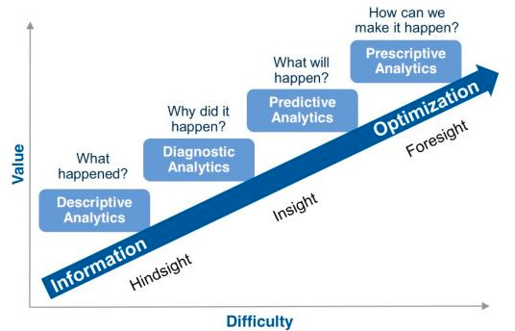
Predictive Health Analytics

Slide 25
The Future?
  Increasing amounts of sensor data will require analysis to decipher and apply to useful applications
  Sensor data will be combined with Geolocation, meteorological, and social information to predict behavior
  Data – Sensors (IoT) will be linked/integrated – Platforms/Standardization.
  Digital Biomarkers - Predictive Analytics – Prescriptive Analytics
  There is a large opportunity for these types of analysis and synthesis of information within Healthcare

Slide 26










Notes:
and we have been noticed by our peers and other media

